Slide 1
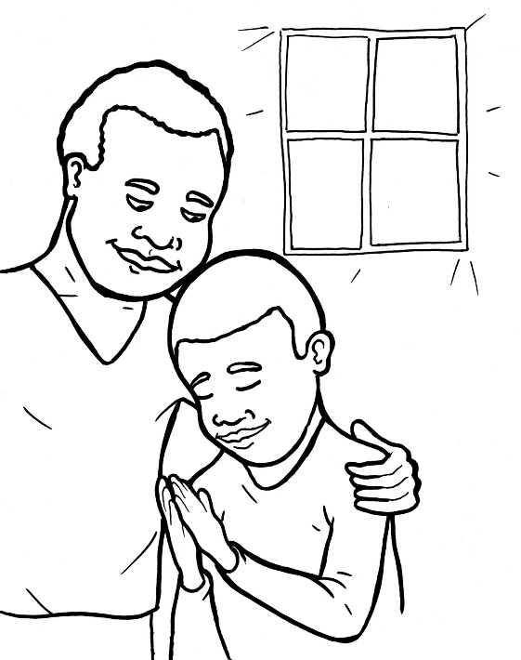

Part 3
50. I am Alive: Prayer
Syllable Divisions

Slide 2
Dividing Words
Into Syllables

Slide 3
Rabbit Words
When you see two consonants
between two vowels,
divide between the consonants.
ra it
bb
rab bit

Slide 4
Chris tian
Christian

Slide 5
or der
order

Slide 6
of ten
often

Slide 7
lis ten
listen

Slide 8
ser vant
servant

Slide 9

Tiger Words
When you see one consonant
between two vowels,
divide after the first vowel.
Try this pattern first.
ti er
g
ti ger

Slide 10
o pens
opens

Slide 11
o bey
obey

Slide 12
re joice
rejoice

Slide 13
a men
amen

Slide 14
Camel Words
When you see one consonant
between two vowels,
divide after the first consonant.
Try this pattern second.
ca el
m
cam el

Slide 15
hon est y
honesty

Slide 16
fam il y
family

Slide 17
ev er y
every

Slide 18
Hamster Words
When you see three consonants between two vowels,
divide after the first consonant.
ha
mst
er
ham ster

Slide 19
an swer
answer

Slide 20
Other Syllable Divisions
Some words don’t fit so neatly
into standard syllable division patterns.

Slide 21
a bout
about

Slide 22
a live
alive

Slide 23
a ma zing
amazing

Slide 24
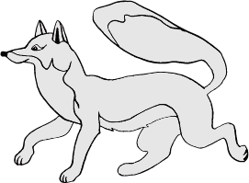
Foxes Suffixes
Focus on your base word.
fox es
fox es

Slide 25
might y
mighty

Slide 26
honest y
honesty

Slide 27
pray ers
prayers

Slide 28
tell ing
telling

Slide 29
pray ing
praying

Slide 30
wait ing
waiting

Slide 31
a ma zing
amazing

Slide 32
friend ship
friendship

Slide 33
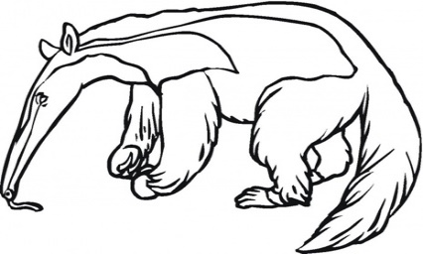
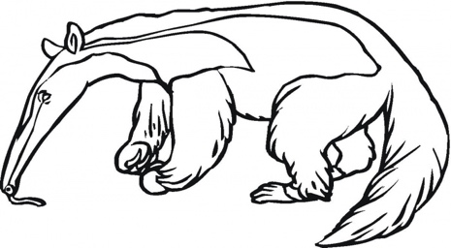
Anteater Words
These compound words are made up of two smaller words.
ant
eater
1
2
ant eater

Slide 34
in to
into

